Slide 1
Sound or No-Sound
sSANKET SANJAYPANT HIRE
2016CS50402
A study on the effect of sound deriving images in evoking emotions

Slide 2
Variable To Analyse: Valence
The main motive to carry out the experimentation was to study how the dimensional variables (Valence, Arousal, Confidence And Novelty) for emotions behave on changing the affective visual stimuli which may or may not derive sound as a perception.
This was an Experiment on Emotions in which we have to rate the above mentioned 4 dimensions on a 9-point scale.
Here Valence is to indicate to what extent did the picture make you feel emotion while viewing it (e.g., extent of attractiveness/averseness).

Slide 3
Image Classification
In this experimentation we took the images from the IAPS dataset and classified the images on the basis of their Sound or No-sound Property.
No-Sound Negative
Man
Sad Face
Woman
Electric Chair
Cemetery
Smoke
Skulls
Hospital
No-Sound Positive
Polar Bears
Butterfly
Flowers
Galaxy
Plant
Bowl
Picnic Table
Ferry
House
Sound Negative
Attack Dog
Tiger
War
Boy
Crying Boy
Aimed Gun
Bomb
Fire
Ship Wave
Explosion
Sound Positive
Children
Kids
Musician
Dance
Violinist
Concert
Ferris Wheel
Athletes
Rollercoaster

Slide 4
Scale Of The Data
We conducted the experiment on 30 students out of which 27 were Male and 3 were Female students.
This experiment comprised of 40 IAPS images.

Slide 5
T-test
A t-test is a type of inferential statistic used to determine if there is a significant difference between the means of two groups, which may be related in certain features.
The samples of Sound Images have a mean valence rating of 4.5 and a Standard Deviation of 1.7
The samples of No-Sound Images have a mean valence rating of 4.6 and Standard Deviation of 1.7

Slide 6
T-test
Here, T-test is performed between the two groups of sound and No-sound IAPS images(20 images each for Sound and No-Sound).
T-value: 2.02
P-value: 0.97 (>0.05)
Since the p-value is greater than 0.05, no significant difference is observed in the means of Sound and No-Sound affective visual stimuli.

Slide 7
T-test
When applied T-test on Negative and Positive Stimuli separately,
p-value of negative valence and positive valence comes out as 0.68 and 0.54 respectively
which is also greater than 0.05,
which consequently explains of no significant difference.

Slide 8
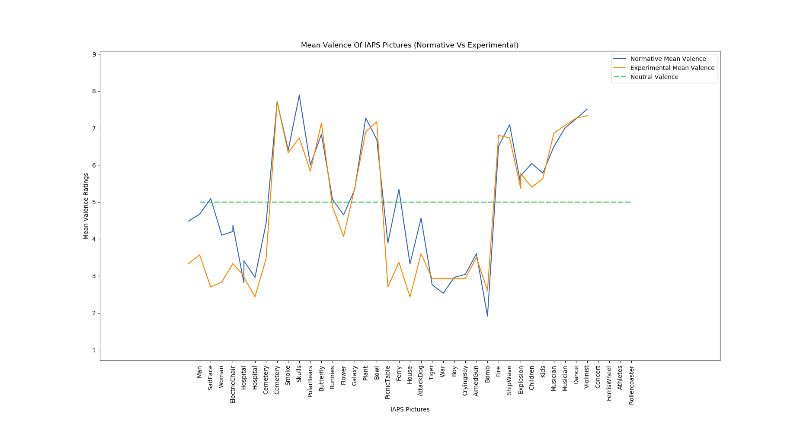
Comparison between Normative Vs Experimental Mean Valence

Slide 9
Observations
From the Graph, We can observe that:
Correlation Coefficient between Normative and Experimental Mean Valence is 0.9289 (high correlation)
The experiment we carried out on small scale gave similar valence rating distribution as the normative valence rating(large scale) to a visual stimuli.
Reasons for slight dissimilar ratings for pictures may be due to:
(a) Cultural Difference
(b) Male Vs Female Distribution, etc.

Slide 10
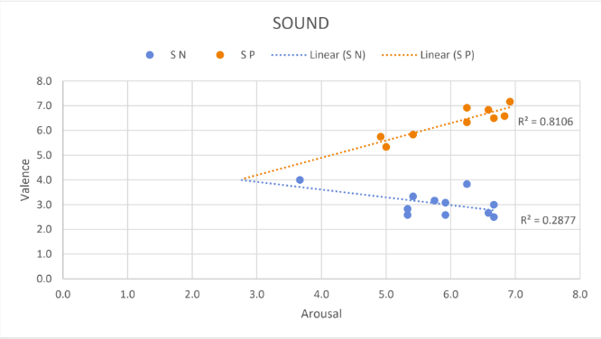
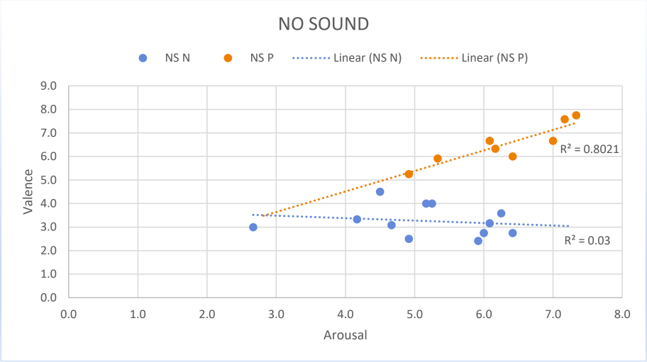
Valence And Arousal
Where, S = Sound, NS = No Sound, N = Negative and P = Positive.
The above 2 boomerang curves show us a linear correlation between valence and arousal.

Slide 11
Valence And Arousal
In case of sound positive and no sound positive,
The slope is positive which expresses a positive correlation between valence and arousal.
Which means valence is directly proportional to arousal.
In case of sound negative and no sound negative,
The slope is negative which expresses a negative correlation between valence and arousal.
Which means valence is inversely proportional to arousal.

Slide 12
Valence And Arousal
In case of positive data, the R-square value is highest for the Sound Positive (i.e R-square = 0.8106) which implies high correlation between Sound Positive and Arousal.
Correlation Coefficients -
No-Sound Positive: 0.895
Sound Positive: 0.9

Slide 13
Valence And Arousal
2) In case of negative data, the R-square value is lowest for the No-Sound Negative (i.e R-square = 0.03) which implies least correlation between No-Sound Negative and Arousal.
Correlation Coefficients -
No-Sound Negative: -0.173
Sound Negative: -0.536

Slide 14
Mean Valence Ratings
No Sound Negative - 3.096
No Sound Positive - 6.21
Sound Negative - 2.993
Sound Positive - 6.423
Sound Negative stimuli produces more negative valence
Sound Positive stimuli produces more positive valence

Slide 15
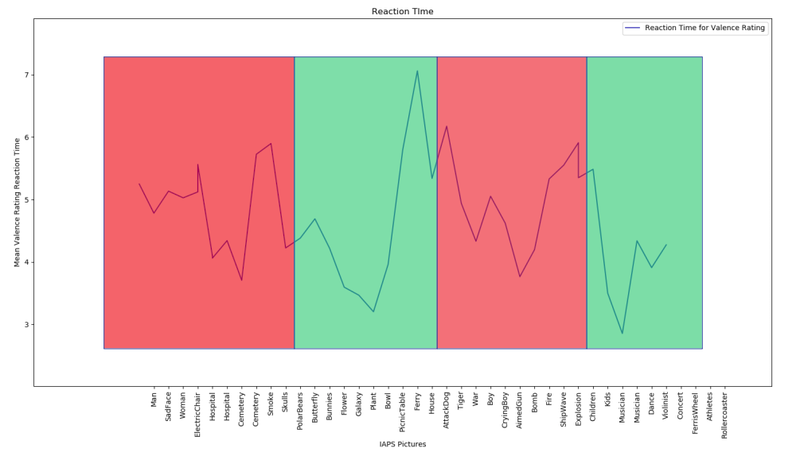
Reaction Timings for Valence Ratings

Slide 16
Mean Reaction Timings for Valence Ratings
No Sound Negative - 4.7071
No Sound Positive - 4.3359
Sound Negative - 5.1269
Sound Positive - 4.6496
No Sound Positive stimuli have least reaction time
Sound Negative stimuli have highest reaction time

Slide 17
THANK YOU!

